Slide 1
Mathematical Methods for Scientific Computing
Partial Differential Equations
Stephen Millmore
Laboratory for Scientific Computing,
University of Cambridge

Slide 2
Partial differential equations
The overall field of partial differential equations is large – you have likely covered many different techniques for solving these equations, e.g. separation of variables
We are not going to cover that here – if we already have an analytic solution technique for the PDE, there is very little need to use scientific computing
Instead, we are going to focus on how PDEs are used in scientific computing, which relates more to equation manipulation and classification, than solution
A wide range of physical problems can be expressed as the solutions to PDEs, often very complex systems of PDEs
In these cases, we would expect our computational methods to do the actual solving
The challenge might often be expressing our system in a manner that can be solved - we need to know something about the behaviour of our system

Slide 3
Outline
1. Classification of PDEs
2. Different forms for PDEs
3. Discontinuities and PDEs

Slide 4
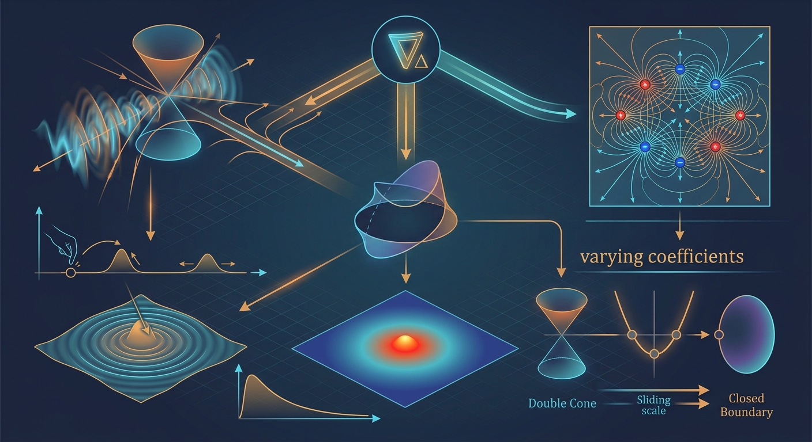
Classification of PDEs

Slide 5
Classification of PDEs
There is no single technique for solving a PDE, or system of PDEs, neither analytically nor in scientific computing
This is based on the mathematical and physical behaviour of the underlying problem
By classifying our PDEs (a mathematical approach), we can attempt to identify whether they are capable of producing the correct physics we wish to capture
And we can also ensure we can identify a computational approach which will allow this behaviour to be captured
More accurately, we can identify a computational approach that is both suitably accurate and suitably efficient for the problem

Slide 6
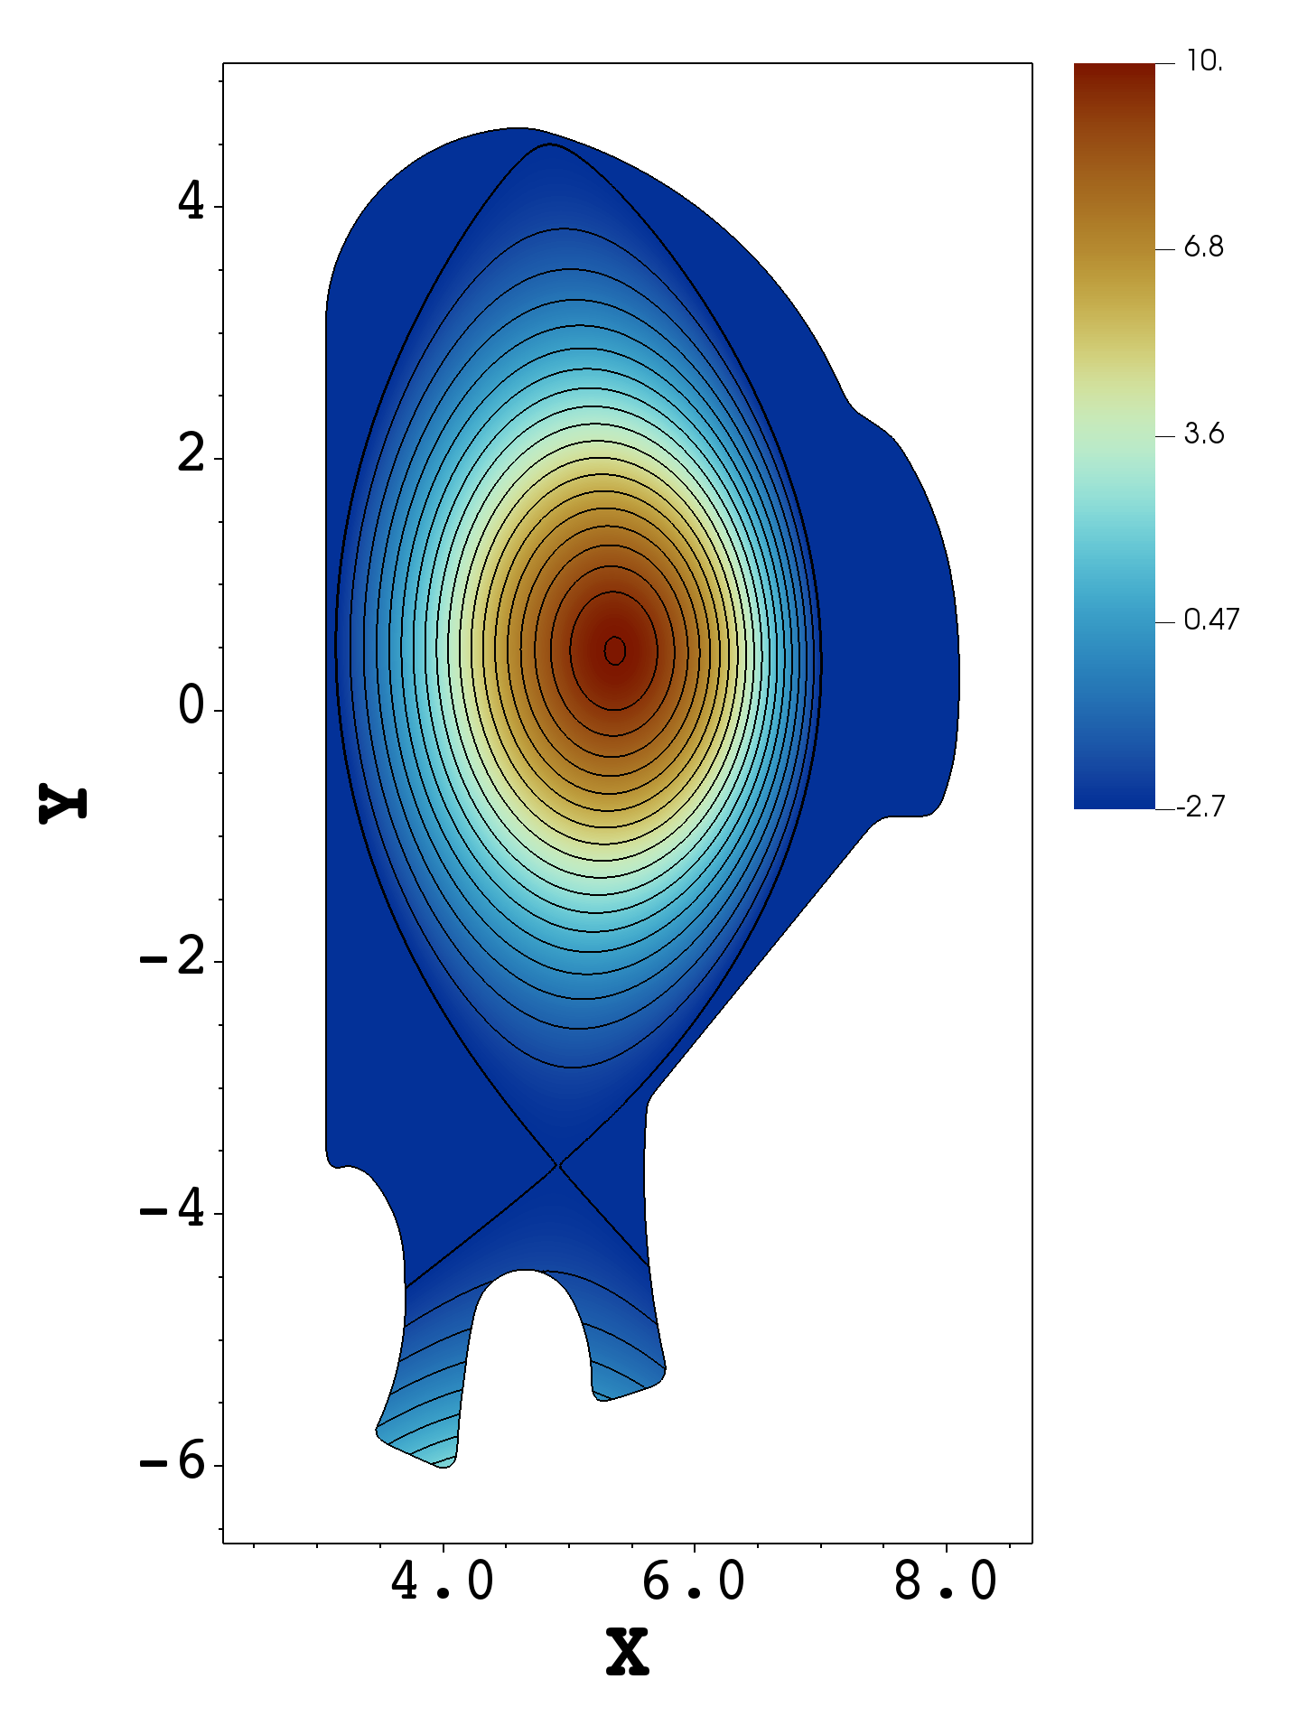
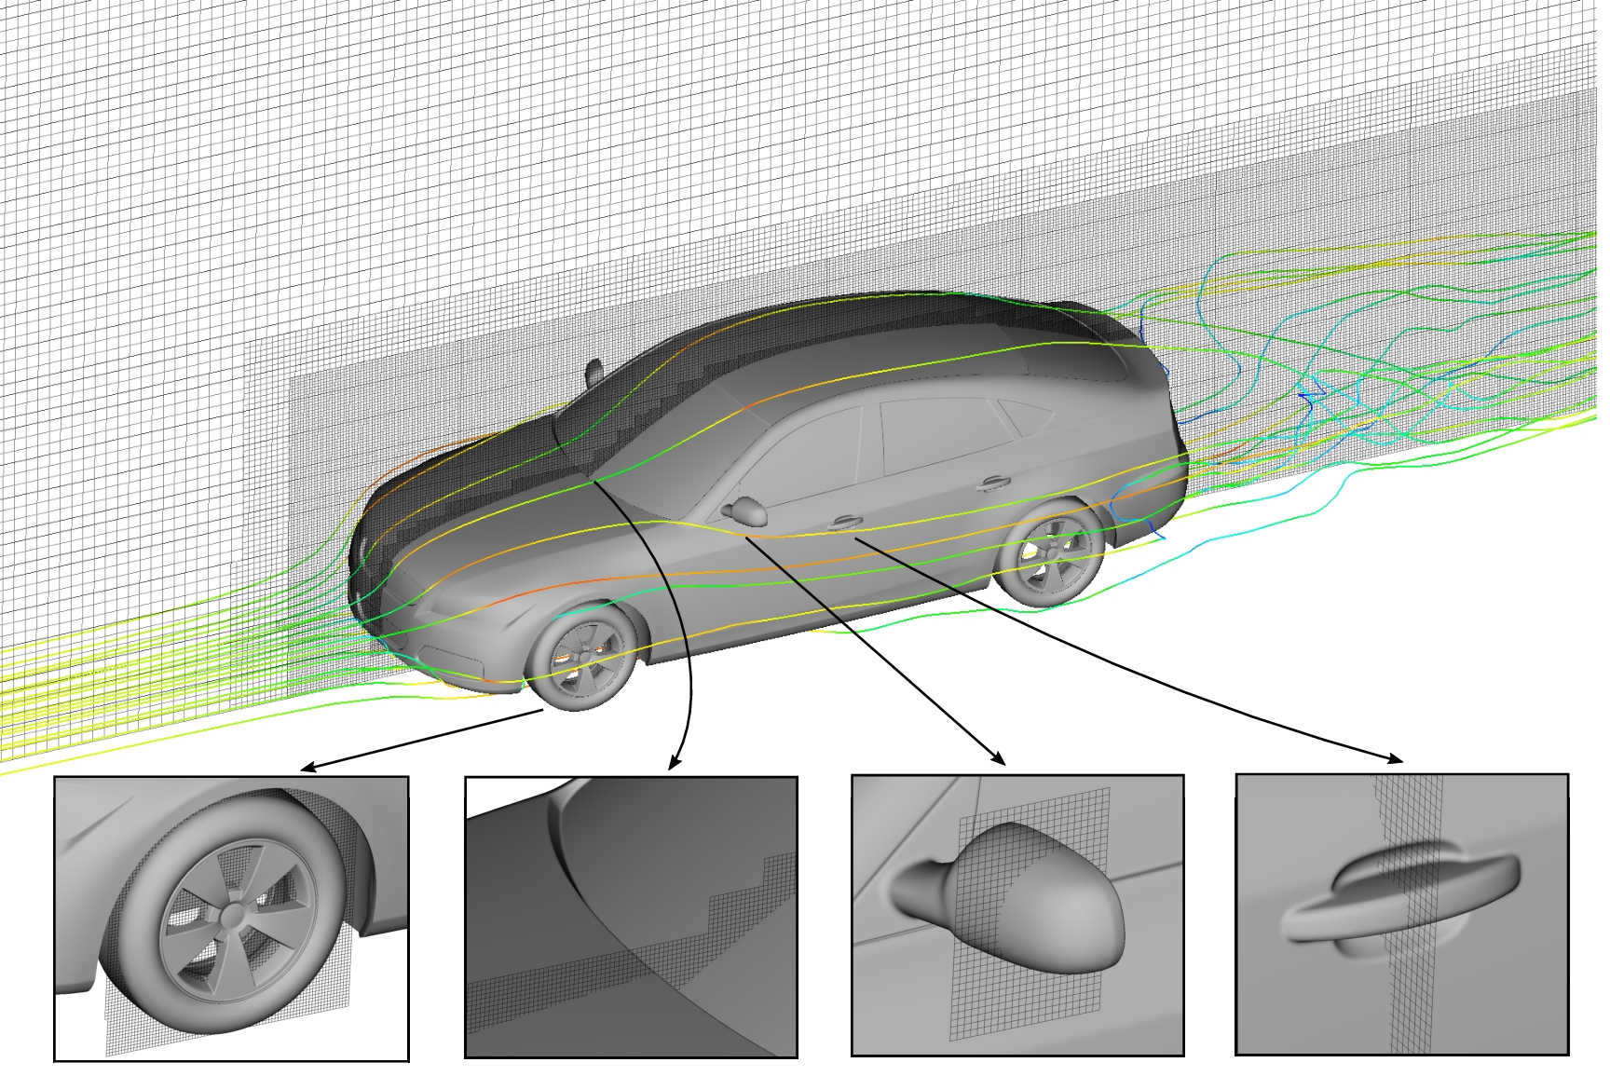
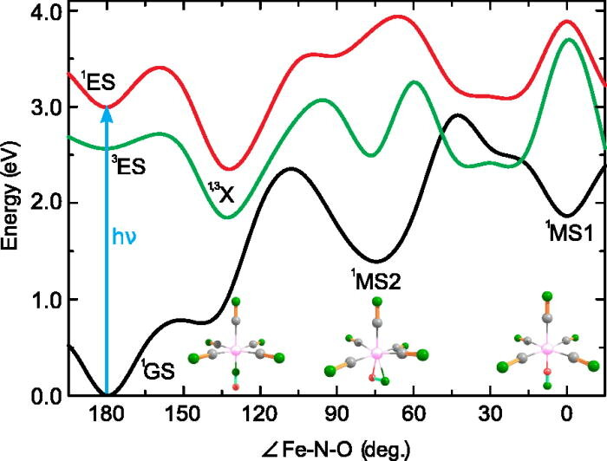
Steady state problems
One class of problem could be those where the solution is a fixed value (typically in time)
This could be considered to be a balance of physical states, for example
– Plasma equilibrium configurations in a tokamak reactor - a perfect balance between pressure gradients and magnetic field
Airflow around an object, e.g. a car or aerofoil – from steady state conditions, lift and drag can be computed
Minimum energy states for a molecular configuration

Slide 7
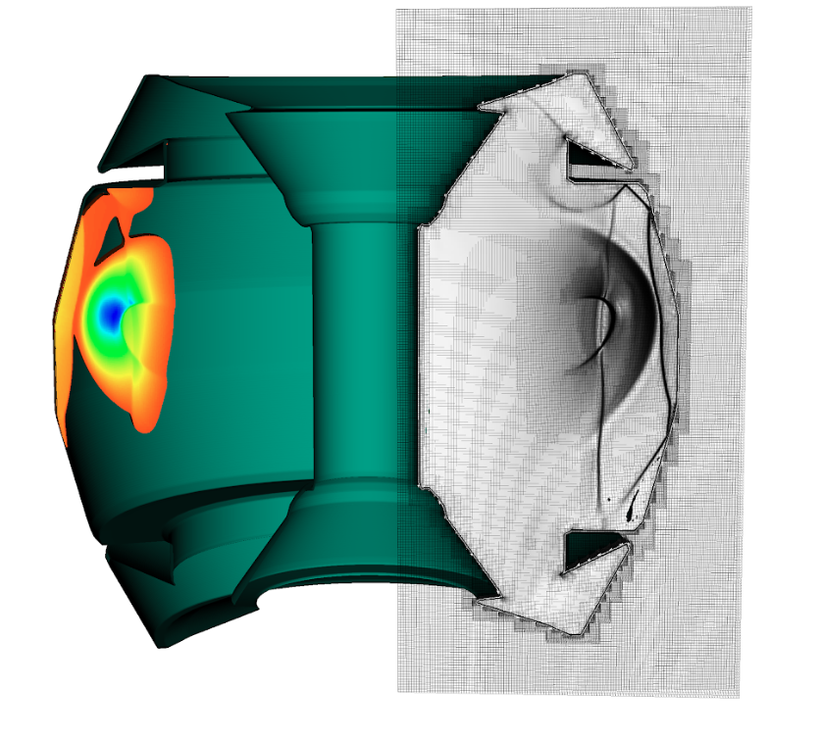
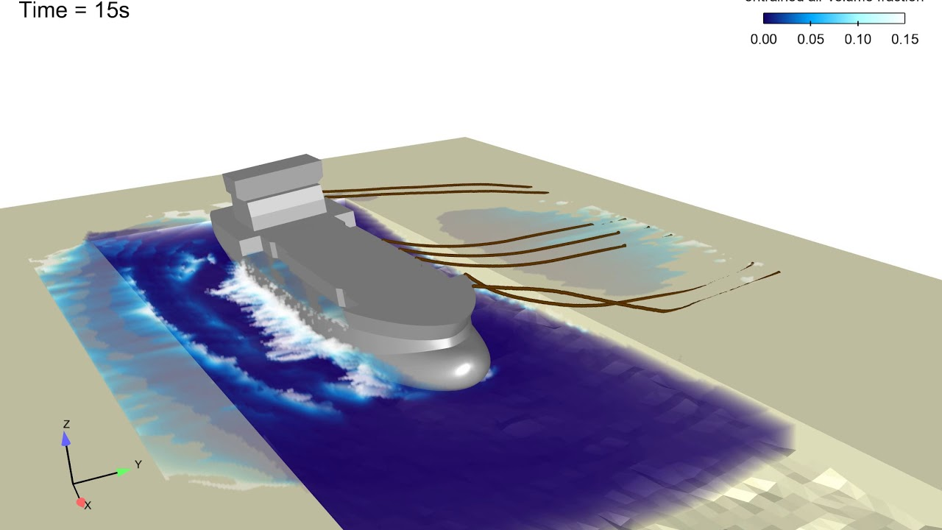
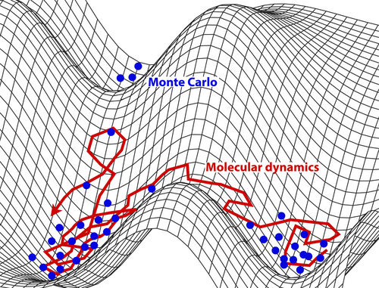
Time-varying problems
Alternatively, our solution may continuously change in space and time
Here, examples include:
Water flow around an object as it moves through the real world
Evolution of atoms according to molecular dynamics
Plasma instabilities in a reactor – a perfect balance is not physically attainable

Slide 8
Mathematical classification
Whilst steady state and time-varying do describe features of the equations, this doesn’t necessarily help us decide upon our numerical method
Mathematically, we use the slope (derivative) of our variables to identify how things are changing, and things change according to some propagation of information
We consider speeds of information propagation
    Equations where all information propagates infinitely fast
  Elliptic equations
    Equations where some information propagates infinitely fast, but some travels with a finite speed
  Parabolic equations
    Equations where all information travels at a finite speed
  Hyperbolic equations
The behaviour in parabolic equations is often also referred to as diffusion

Slide 9
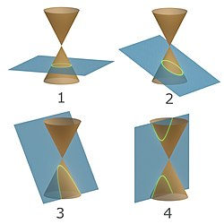
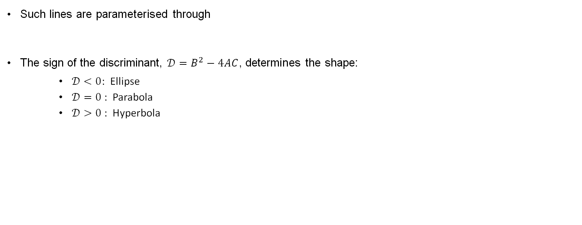
Classification — conic sections
Classification of PDEs is actually a wide area with ongoing research — we shall only consider a few examples
One example starts with drawing comparisons to conic sections
(the lines through which a cone can be cut)
Such lines are parameterised through
The sign of the discriminant, $𝒟=B^{2}−4AC$, determines the shape:
    $𝒟<0$: Ellipse
    $𝒟=0$: Parabola
    $𝒟>0$: Hyperbola

Slide 10
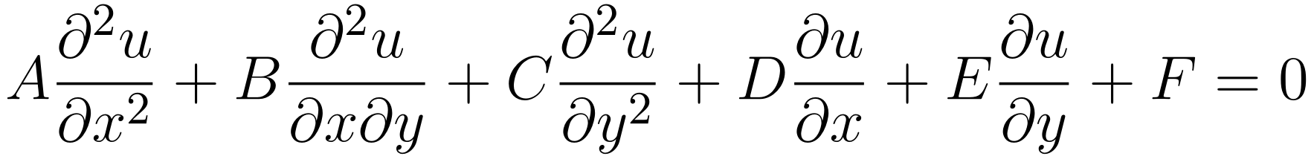
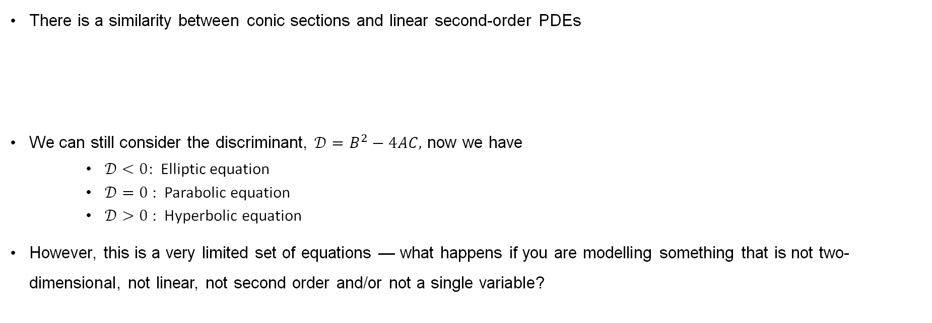
Classification — linear second-order PDEs
There is a similarity between conic sections and linear second-order PDEs
We can still consider the discriminant, $𝒟=B^{2}−4AC,$ now we have
    $𝒟<0$: Elliptic equation
    $𝒟=0$: Parabolic equation
    $𝒟>0$: Hyperbolic equation
However, this is a very limited set of equations — what happens if you are modelling something that is not two-dimensional, not linear, not second order and/or not a single variable?

Slide 11
Classification of the Laplacian

Slide 12
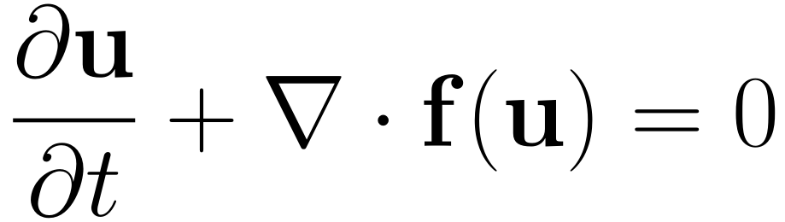
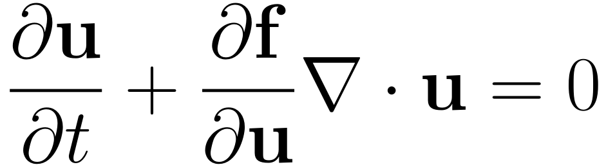
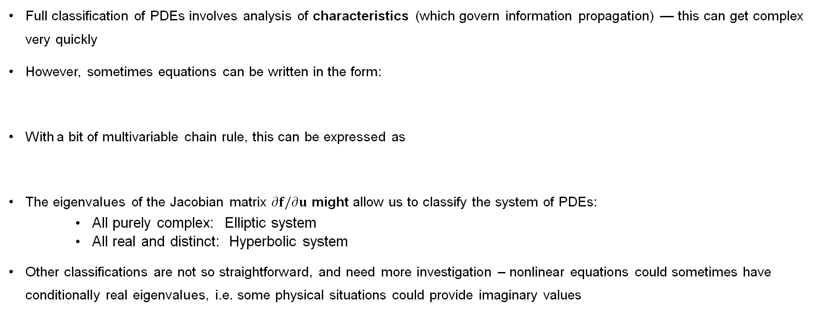
Classification — systems
Full classification of PDEs involves analysis of characteristics (which govern information propagation) — this can get complex very quickly
However, sometimes equations can be written in the form:
With a bit of multivariable chain rule, this can be expressed as
The eigenvalues of the Jacobian matrix $∂f/∂u$ might allow us to classify the system of PDEs:
    All purely complex: Elliptic system
    All real and distinct: Hyperbolic system
Other classifications are not so straightforward, and need more investigation – nonlinear equations could sometimes have conditionally real eigenvalues, i.e. some physical situations could provide imaginary values

Slide 13
Classification of simple PDEs

Slide 14
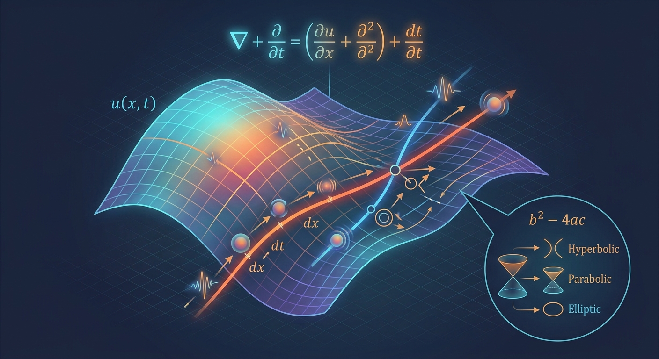
Different Forms for PDEs

Slide 15
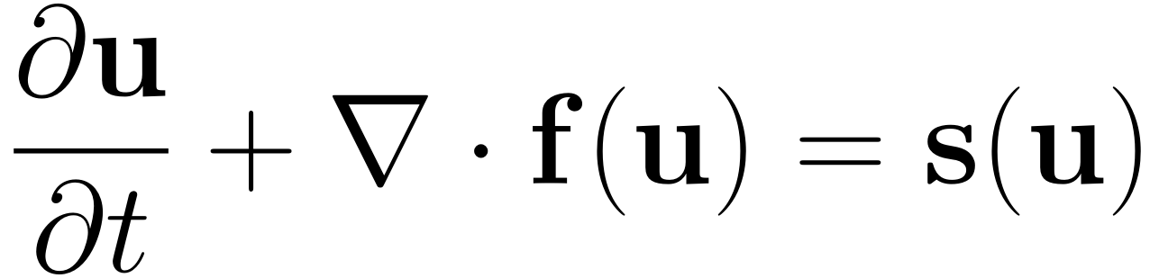
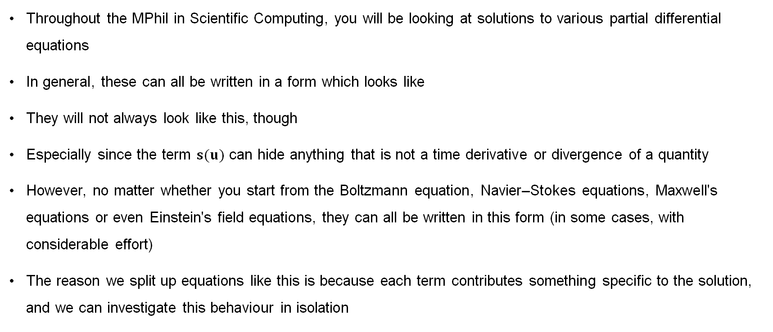
Different forms of PDEs
Throughout the MPhil in Scientific Computing, you will be looking at solutions to various partial differential equations
In general, these can all be written in a form which looks like
They will not always look like this, though
Especially since the term $s(u)$ can hide anything that is not a time derivative or divergence of a quantity
However, no matter whether you start from the Boltzmann equation, Navier–Stokes equations, Maxwell's equations or even Einstein's field equations, they can all be written in this form (in some cases, with considerable effort)
The reason we split up equations like this is because each term contributes something specific to the solution, and we can investigate this behaviour in isolation

Slide 16
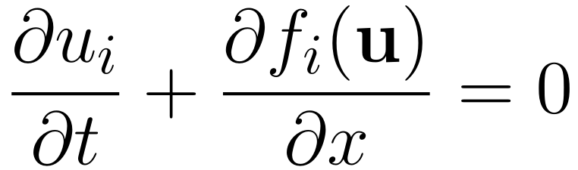
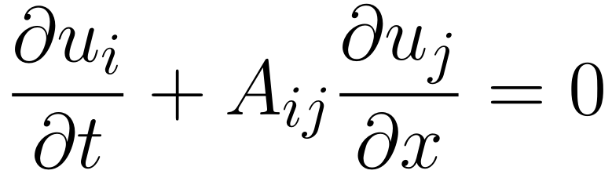
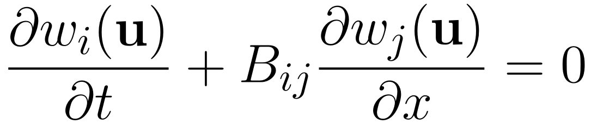
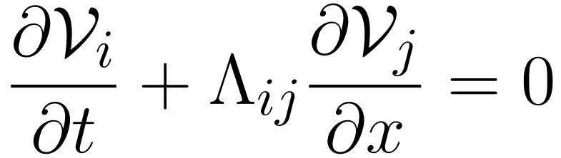
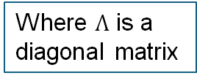
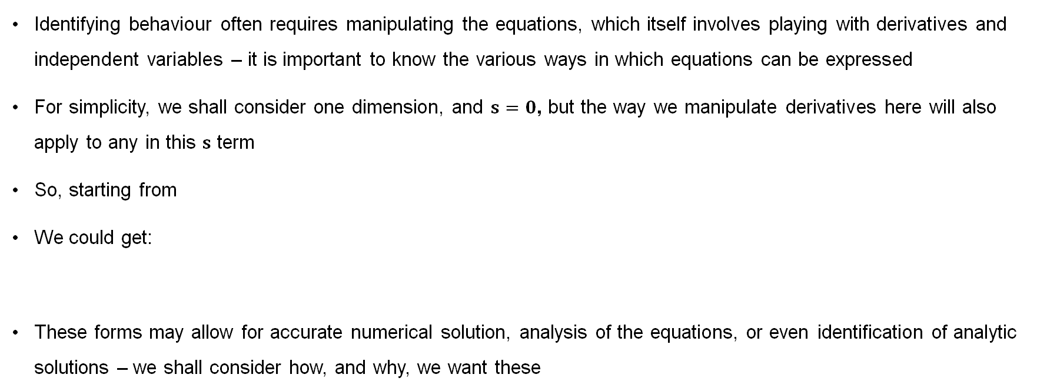
Commonly encountered forms
Identifying behaviour often requires manipulating the equations, which itself involves playing with derivatives and independent variables – it is important to know the various ways in which equations can be expressed
For simplicity, we shall consider one dimension, and $s=0$, but the way we manipulate derivatives here will also apply to any in this $s$ term
So, starting from
We could get:
These forms may allow for accurate numerical solution, analysis of the equations, or even identification of analytic solutions – we shall consider how, and why, we want these
Where $Λ$ is a diagonal matrix

Slide 17
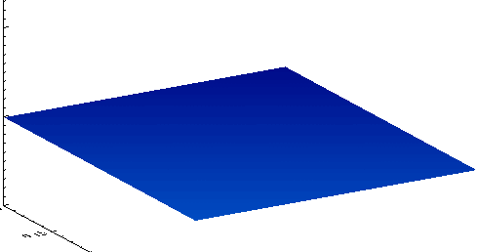
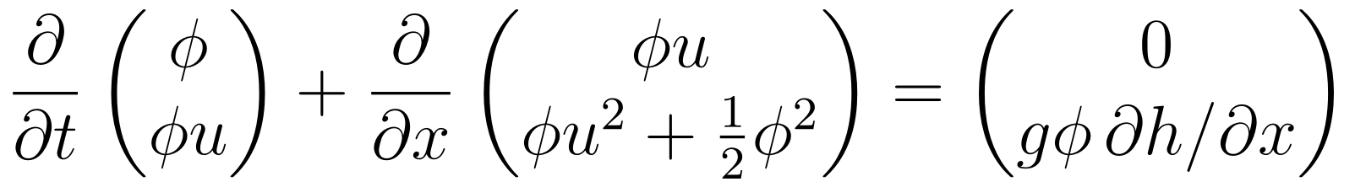
An example — the shallow water equations
As a simple, but non-trivial, example to demonstrate these different forms, and some of the mathematical techniques used, we consider the shallow water equations
They are a reduction of the Navier–Stokes equations, and are a suitable approximation for systems where there is a vertical length scale much smaller than other length scales (such as shallow water)
Source: Dan Copsey, own work, wikipedia

Slide 18
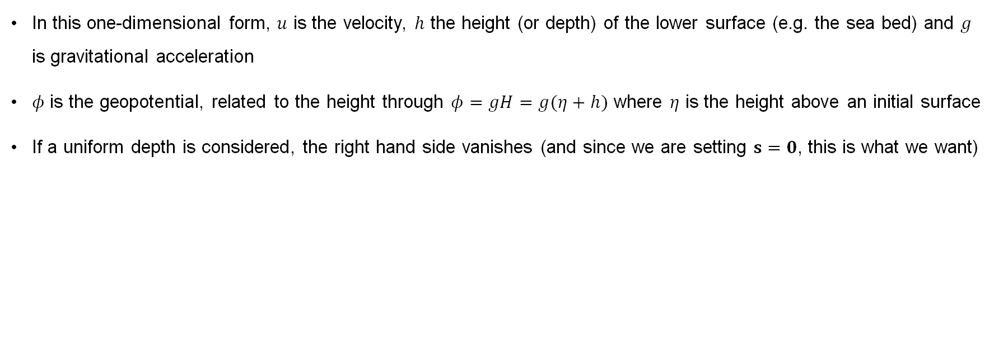
An example — the shallow water equations
In this one-dimensional form, $u$ is the velocity, $h$ the height (or depth) of the lower surface (e.g. the sea bed) and $g$ is gravitational acceleration
$φ$ is the geopotential, related to the height through $φ=gH=g(η+h)$ where $η$ is the height above an initial surface
If a uniform depth is considered, the right hand side vanishes (and since we are setting $s=0$, this is what we want)
Source: Dan Copsey, own work, wikipedia

Slide 19
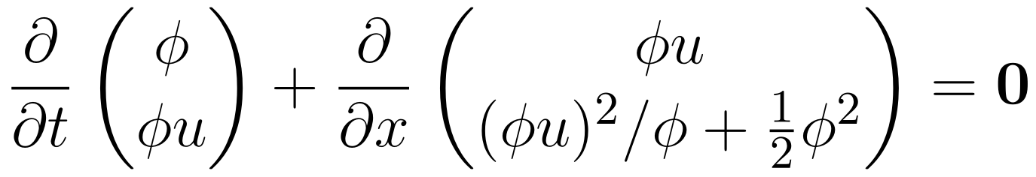
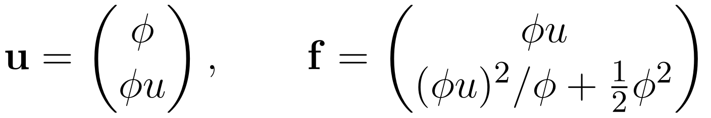
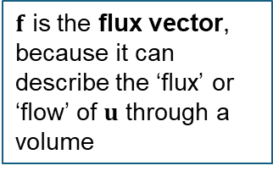
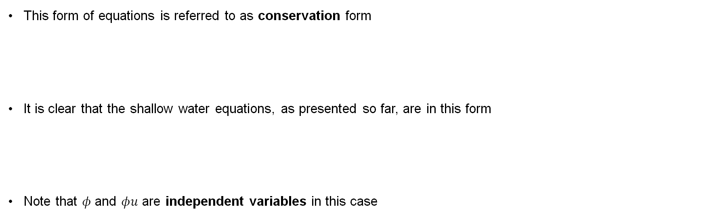
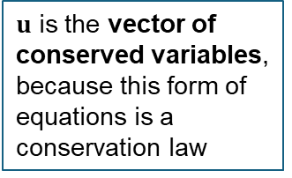
Conservation form
This form of equations is referred to as conservation form
It is clear that the shallow water equations, as presented so far, are in this form
Note that $φ$ and $φu$ are independent variables in this case
$u$ is the vector of conserved variables, because this form of equations is a conservation law
$f$ is the flux vector, because it can describe the ‘flux’ or ‘flow’ of $u$ through a volume

Slide 20
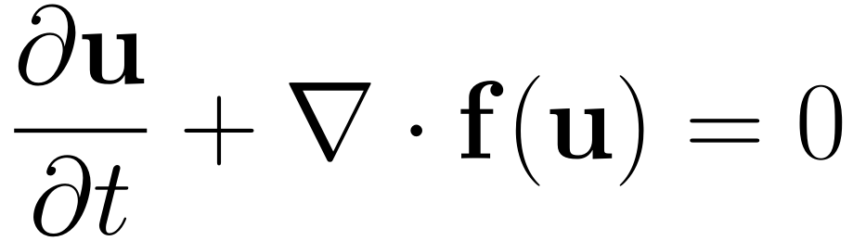
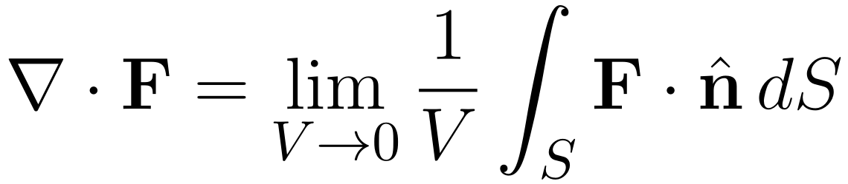
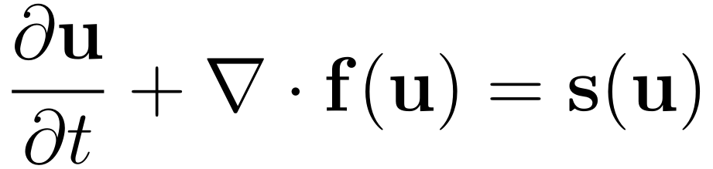
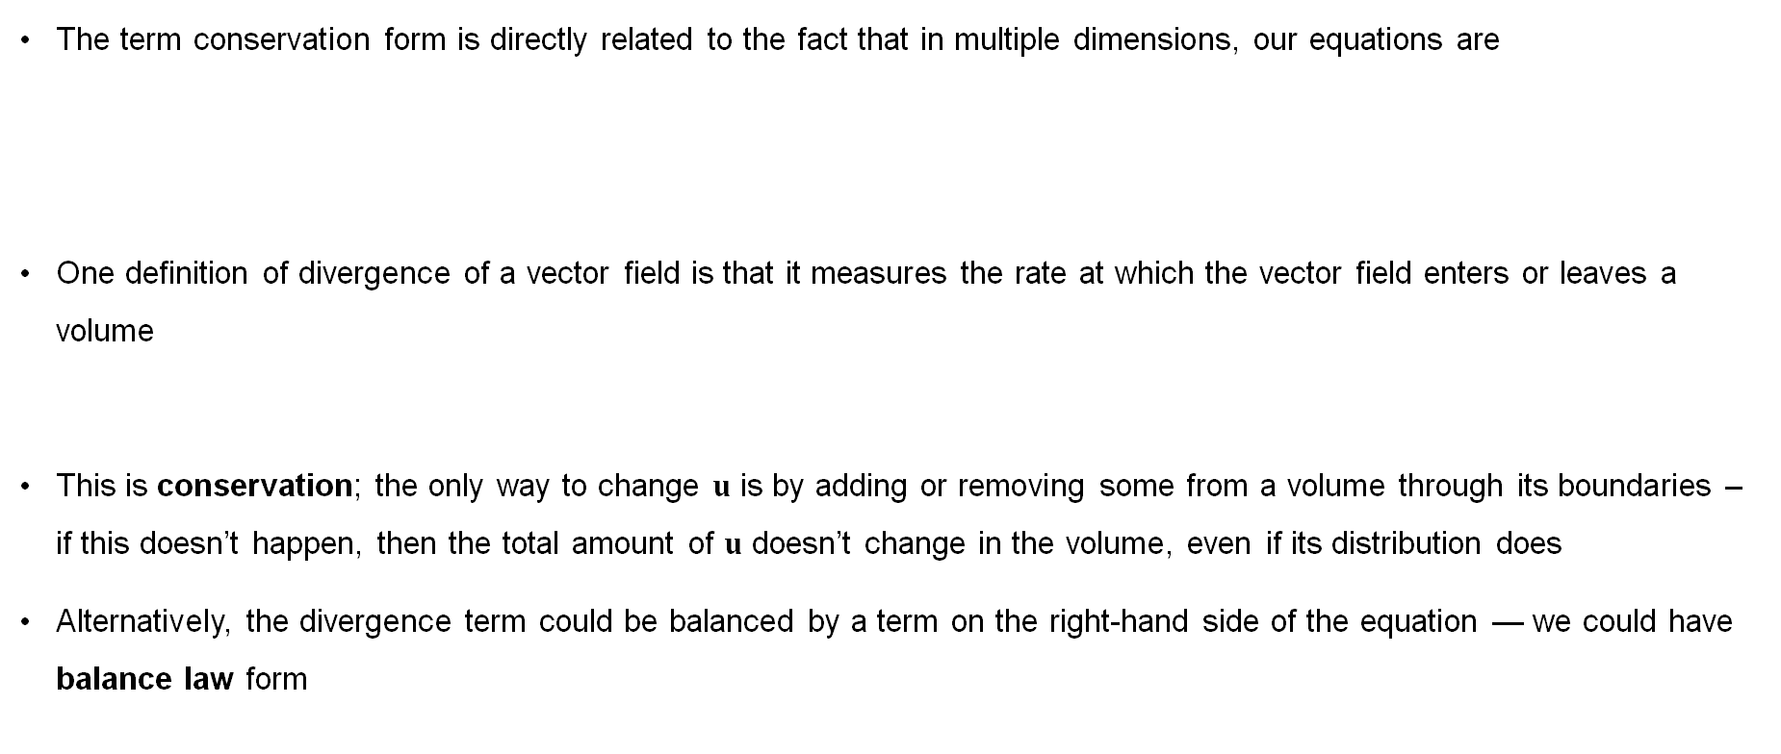
Conservation form
The term conservation form is directly related to the fact that in multiple dimensions, our equations are
One definition of divergence of a vector field is that it measures the rate at which the vector field enters or leaves a volume
This is conservation; the only way to change $u$ is by adding or removing some from a volume through its boundaries – if this doesn’t happen, then the total amount of $u$ doesn’t change in the volume, even if its distribution does
Alternatively, the divergence term could be balanced by a term on the right-hand side of the equation — we could have balance law form
Conservation form is a fundamental part of compressible fluid dynamics

Slide 21
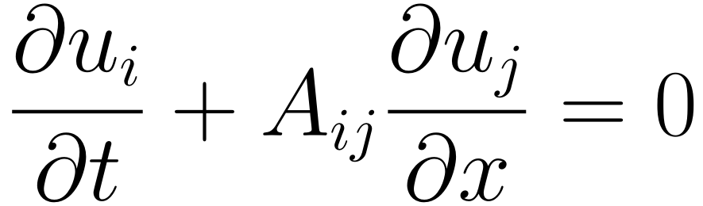
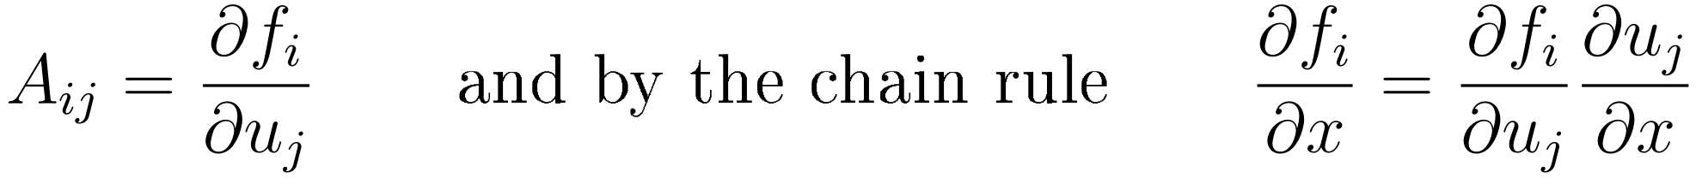
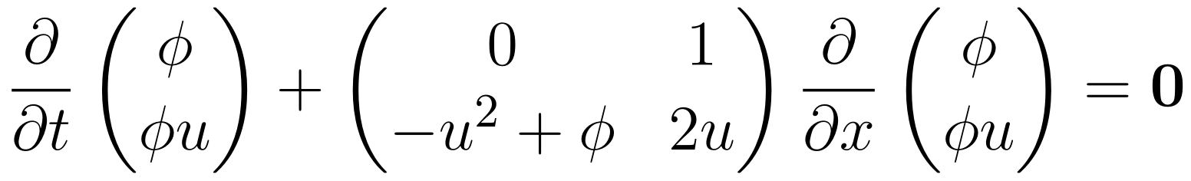
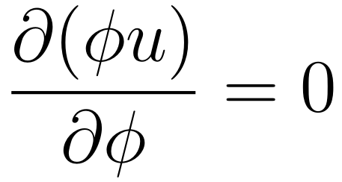
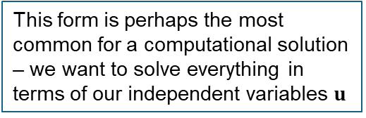
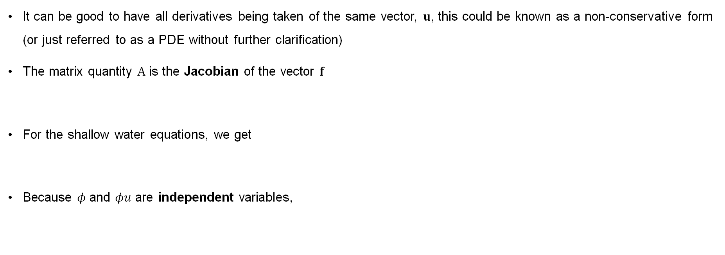
Non-conservation form (and the Jacobian)
This form is perhaps the most common for a computational solution – we want to solve everything in terms of our independent variables $u$
It can be good to have all derivatives being taken of the same vector, $u$, this could be known as a non-conservative form (or just referred to as a PDE without further clarification)
The matrix quantity $A$ is the Jacobian of the vector $f$
For the shallow water equations, we get
Because $φ$ and $φu$ are independent variables,

Slide 22
Non-conservation form

Slide 23
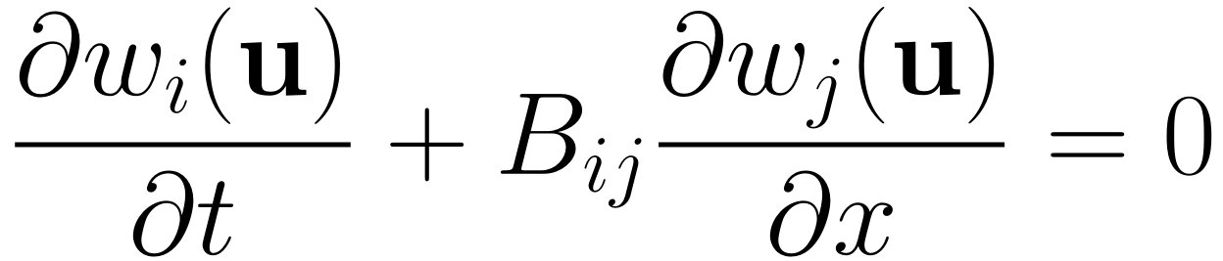
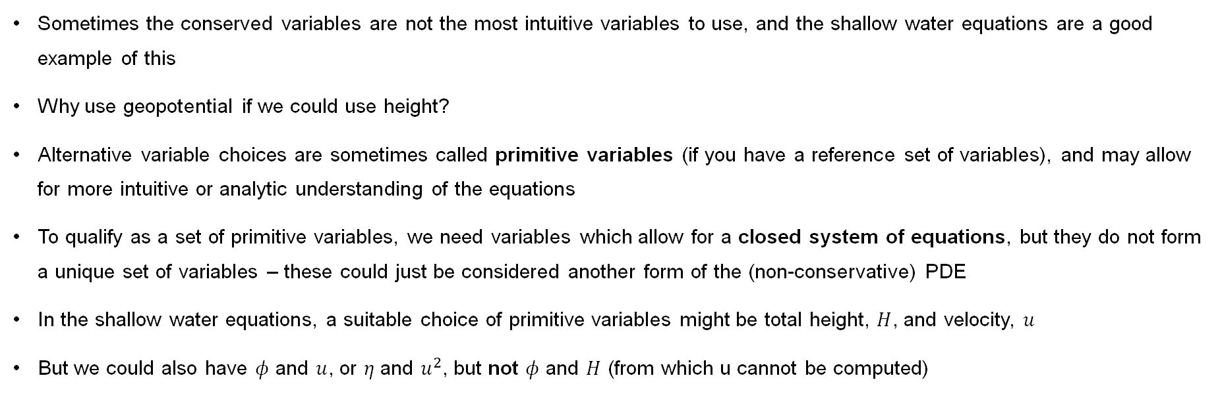
Primitive-variable form
Sometimes the conserved variables are not the most intuitive variables to use, and the shallow water equations are a good example of this
Why use geopotential if we could use height?
Alternative variable choices are sometimes called primitive variables (if you have a reference set of variables), and may allow for more intuitive or analytic understanding of the equations
To qualify as a set of primitive variables, we need variables which allow for a closed system of equations, but they do not form a unique set of variables – these could just be considered another form of the (non-conservative) PDE
In the shallow water equations, a suitable choice of primitive variables might be total height, $H$, and velocity, $u$
But we could also have $φ$ and $u$, or $η$ and $u^{2}$, but not $φ$ and $H$ (from which u cannot be computed)

Slide 24
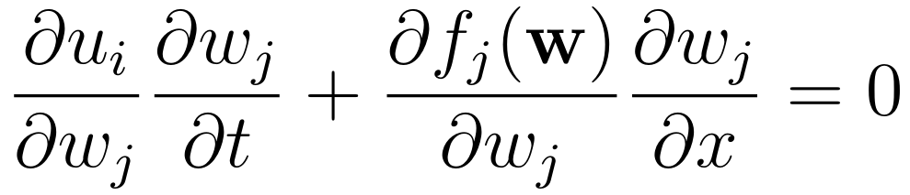
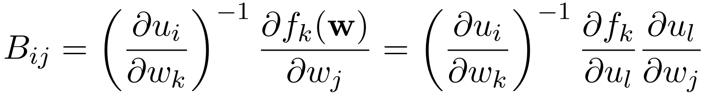
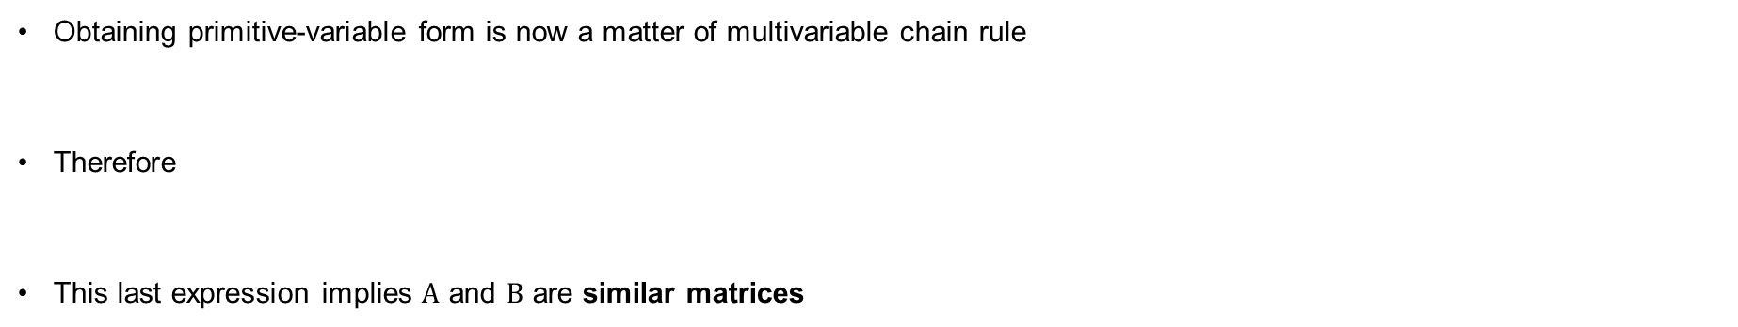
Primitive-variable form (continued)
Even if your system of equations doesn’t have the common concept of primitive variables, we are really introducing this to show how variable transformations happen
Obtaining primitive-variable form is now a matter of multivariable chain rule
Therefore
This last expression implies $A$ and $B$ are similar matrices

Slide 25
Primitive form

Slide 26
Primitive form

Slide 27
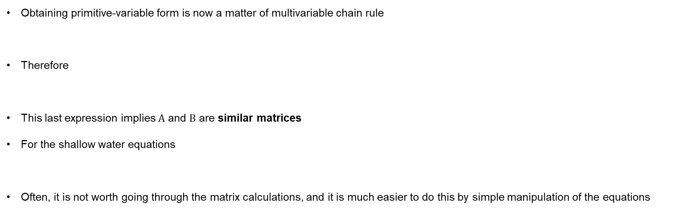
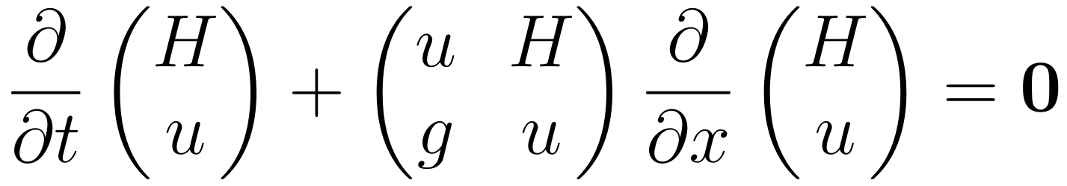
Primitive-variable form (continued)
Even if your system of equations doesn’t have the common concept of primitive variables, we are really introducing this to show how variable transformations happen
Obtaining primitive-variable form is now a matter of multivariable chain rule
Therefore
This last expression implies $A$ and $B$ are similar matrices
For the shallow water equations
Often, it is not worth going through the matrix calculations, and it is much easier to do this by simple manipulation of the equations

Slide 28
Primitive form SW

Slide 29
Primitive form SW

Slide 30
Primitive form SW

Slide 31
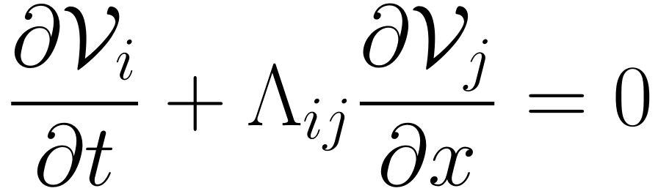
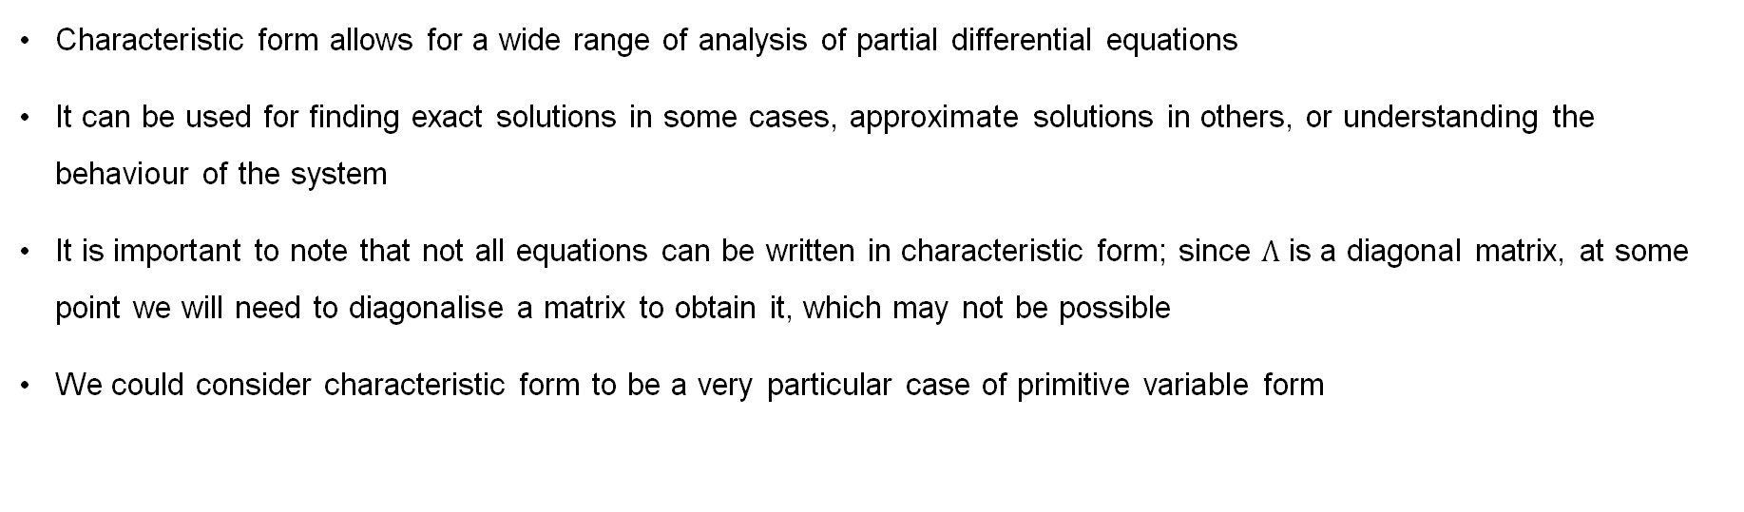
Characteristic form
Characteristic form allows for a wide range of analysis of partial differential equations
It can be used for finding exact solutions in some cases, approximate solutions in others, or understanding the behaviour of the system
It is important to note that not all equations can be written in characteristic form; since $Λ$ is a diagonal matrix, at some point we will need to diagonalise a matrix to obtain it, which may not be possible
We could consider characteristic form to be a very particular case of primitive variable form

Slide 32



Characteristic form (continued)
We need to find a matrix, $C$, such that$({C_{ik})}^{−1}A_{kl}C_{lj}$ is diagonal
In doing so, we will effectively choose the 'primitive' variables for this case, since
This may well be familiar — we are diagonalising the Jacobian to achieve this
Therefore the entries of $Λ$ are the eigenvalues of $A$, and $C_{ik}$ and $({C_{ik})}^{−1}$ are matrices of the eigenvectors and its inverse respectively

Slide 33
Characteristic form SW

Slide 34
Characteristic form SW

Slide 35
Characteristic form SW

Slide 36
Characteristic form SW

Slide 37
Characteristic form SW

Slide 38
Characteristic form SW

Slide 39



Shallow water equations’ eigenvalues and eigenvectors
Two eigenvalues,
These eigenvalues are both real and distinct — we know we can write the equation in characteristic form as a result
The right eigenvectors of $B$ are
The matrix of right eigenvectors is then

Slide 40


Shallow water equations’ eigenvalues and eigenvectors
The inverse of this matrix is now
We now have, as expected,
Now all we need is $𝓥$

Slide 41



Characteristic form of the shallow water equations
Note that (for well behaved $w$ and $𝓥$)
This means we can integrate both sides with respect to $w$ to get $𝓥$
This gives
Characteristic form is not pretty, but it is powerful, the quantities in the diagonal matrix tell us a lot about how the system behaves, and how the variables are coupled

Slide 42


Summary
Four different ways to express the same equation
They are all used at different times, and are not an exhaustive list of how we could express this equation

Slide 43



Second-order PDEs
Another way equations can be manipulated is that second-order PDEs can be obtained from a system of first-order PDEs (or vice-versa)
Consider
If we take additional derivatives of $\overline{u}$ with respect to time and of $\overline{v}$ with respect to space, we get
This is the wave equation, and we know we can write it as a system of first-order PDEs (which may be easier to solve)
However, working backwards is not always as straightforward — reintroducing $\overline{v}$ by integrating the wave equation is difficult

Slide 44
Wave equation

Slide 45
Wave equation

Slide 46

Discontinuities and PDEs

Slide 47


Integral form of a differential equation
It is probably most common to find the equations in scientific computing written as (partial) differential equations, e.g.
There are sometimes reasons that we don’t want to do this, though
For example, for this equation to be valid, we require that $u$ is differentiable
Mathematically, there is no reason for any arbitrary function $u(x,t)$ that this is true and it is possible for functions which are initially smooth to evolve to be non-differentialble
If this happens, we cannot solve this form of the equations, but must instead solve the integral form
In other cases, numerical methods may actually work better if everything is written as an integral – you may be able to make use of orthogonality properties or make your boundary conditions easier

Slide 48


Discontinuities
When we talk about a solution becoming non-differentiable, we are also saying that our function $u$ becomes discontinuous
Common types of discontinuity are material interfaces and shock waves
In reality, neither of these is a true discontinuity; there is always some form of transition, which, if you are on the atomistic stream, you would be resolving
Thermal diffusion, no matter how small, exists over shock waves
Materials undergo a transition region, which may be a region on the scale of just a few atoms, but noticeable all the same
But there are good reasons that our equations allow discontinuities to form
Source: nasa.gov

Slide 49

Singularities
Referring to an equation as forming a singularity is another way in which this mathematical behaviour is often described
From a continuum point of view, features like shock waves and material interfaces are often best treated as true discontinuities because the simulation cannot model the true transition scales
Elsewhere, singular behaviour occurs when your equations stop being physically valid – either by design (you need to know when the black hole forms) or by limitation of a model (you are moving into a new physics/chemistry regime)
This means sometimes you stop your simulation at this point, but integral form exists for when you need to continue!
Source: https://www.eso.org/public/images/eso0903a/

Slide 50



Integral domain
Consider a differential equation
In order to convert this to an integral equation, we first define some area we are trying to solve this equation over
Typically, we would consider the case in which we know the solution at a point in time, $u(t_{1},x), x∈[a,b]$
And we want to solve it for some (or all) times up until $t₂$, still for $x∈[a,b]$
We can integrate our differential equation over this entire region

Slide 51
Integral form

Slide 52


Integral form and conservation laws
Begin with the assumption that u is continuous, and integrate
We can then use the fundamental theorem of calculus
In this form, it would not matter if u was discontinuous — a solution could still be obtained
We shall not detail how you might now find a solution, for that you will need other courses
For example, I will tell you how to do this for compressible gases in “Numerical Methods for Compressible Fluid Dynamics”

Slide 53


Weak solutions
A weak solution is defined as a solution of
which may, or may not, be discontinuous
If it is discontinuous, it cannot satisfy
However, this discontinuous solution is indeed a (weak) solution to the underlying physical problem, just not one that can be found by considering this form of the governing equation (because this governing equation made assumptions about the solution which don’t actually hold)
It is important to note that when solving for $u$ on $x∈[a,b], t∈[t₁,t₂],$ weak solutions may not be unique. If you stick with my lectures, you will see this, but otherwise you might imagine that this arises because different functions can have the same area (same integral) between $a$ and $b$, but would have different slopes

